Slide 1
Leveraging Technology to Improve Customer Experience
PIP104 University Project-II
Review-2
Batch Number:
Roll Number | Student Name
20211CSE0391 | Rachana Varadaraj
20211CSE0353 | Mohammed Tauseef Ahmed
20211CSE0365 | Dhriteshree M R
20211CSE0359 | Mohammed Zahid Hasan
Under the Supervision of,
Dr. Jothish C
Associate Professor
School of Computer Science & Engineering
Presidency University

Slide 2
Introduction
The insurance industry plays a vital role in providing financial security by covering risks such as health emergencies, accidents, or property damage. However, customers often struggle to understand their insurance policies due to the complex terms, lengthy documents, and legal jargon. This is how emerging technologies are improving transparency in the insurance industry, making policies more accessible, and fostering better trust between customers and insurers. The goal is to identify effective solutions that not only simplify policy documents but also ensure that customers fully understand their coverage, resulting in higher satisfaction and fewer disputes.

Slide 3
Literature Review
The insurance industry can benefit from several technological solutions to make scanned documents more understandable. From the referred research papers and the project we are aiming to create, the following technologies are required:
Web-based Applications: Web-based applications for scanning insurance documents offer several benefits, streamlining the process of managing paperwork.
Applications of API Integration in Web Development: API integrations, such as for language translations or text summarization, are instrumental in creating interactive and intelligent web applications. They allow developers to access powerful machine-learning models without extensive local resources, significantly enhancing functionality.

Slide 4
Objectives
Simplifying Insurance Information Access
User-Friendly Navigation and Interface
Personalized User Experience
Enhanced Insurance Detail Viewing
Summarization and Accessibility
Future Comparison Functionality

Slide 5
Methodology
Analysis of Requirements: Stakeholder Engagement, Functional and Non-Functional Requirements
System Design: Architecture Design, Database Schema, User Interface Design
Technology Stack Selection: Frontend, Backend, Database, Libraries/Tools
Implementation: Project Setup, Frontend and Backend Development
Monitoring and Maintenance: Monitoring, Feedback Collection, Regular Maintenance

Slide 6
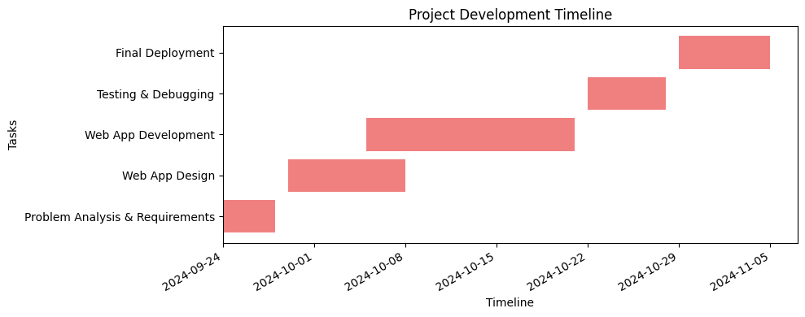
Timeline of Project

Slide 7
Expected Outcomes
Simplified Insurance Documents: Automated generation of easily understandable summaries of policy documents by removing jargon and complex terms.
Improved Customer Engagement: Increased policyholder interaction with documents, leading to better understanding and informed decision-making.
Reduced Miscommunication: Fewer instances of misunderstandings in coverage, exclusions, and claims due to clearer information presentation.
Enhanced Trust: Strengthened trust between insurers and customers, fostering long-term relationships.

Slide 8
Conclusion
The integration of technology into insurance processes has emerged as a powerful tool for enhancing transparency and accessibility. By scanning insurance documents and utilizing advanced technologies, insurers can improve customer experience, reduce disputes, enhance efficiency and strengthen compliance. These advancements will likely drive even greater improvements in insurance transparency, making it easier for policyholders to understand and manage their coverage.
By embracing these technological solutions, insurers can position themselves as customer- centric organizations that prioritize transparency, trust, and a positive policyholder experience.

Slide 9
References
K. Ganesan et al., "Text Summarization Techniques in Insurance Platforms: A Review," Journal of Data and Information Systems, 2018.
J. Kim et al., "Database Integration for Secure Web Applications," in Proceedings of Web Technologies and Systems, 2020.
L. Morrison et al., "Accessibility in Modern Web Applications: Best Practices," International Journal of Human-Computer Interaction, 2019.
J. Nielsen, "Web Usability and Navigation Principles," Usability Research Lab, 2018.
R. Patterson et al., "Designing Effective Dashboards: A User-Centric Approach," User Experience Journal, 2014.
P. Rao et al., "Digital Transformation in Insurance: Trends and Challenges," Journal of Financial Technologies, 2020.
A. Singh and N. Gupta, "Impact of Comparison Tools in Insurance Platforms," Insurance Technology Review, 2021.
L. Zhang et al., "API-Driven Development: Case Studies in Insurance Platforms," in ACM Web Science Conference Proceedings, 2022.

Slide 10
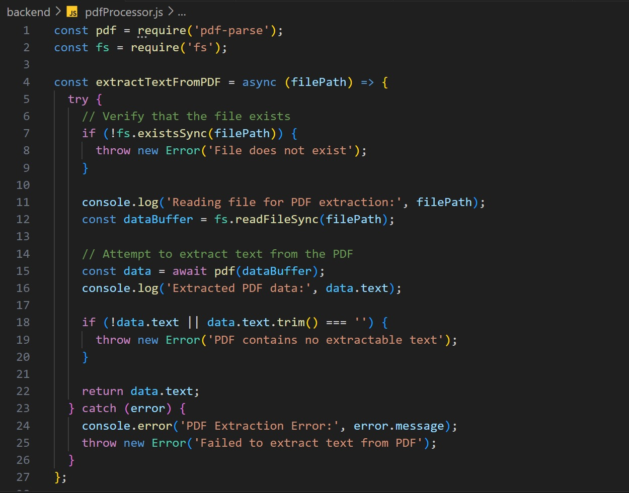
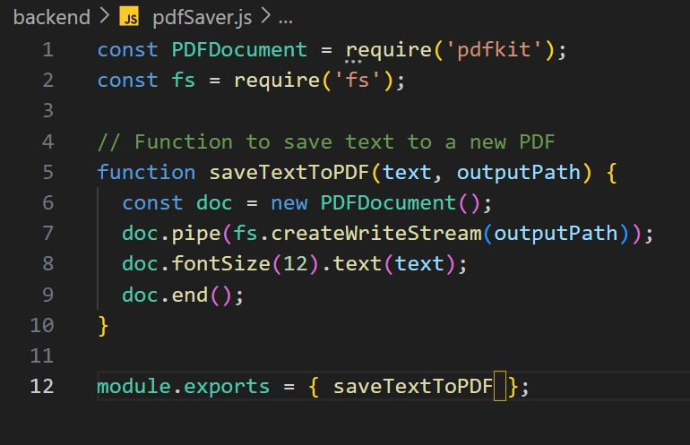
PSEUDOCODE

Slide 11
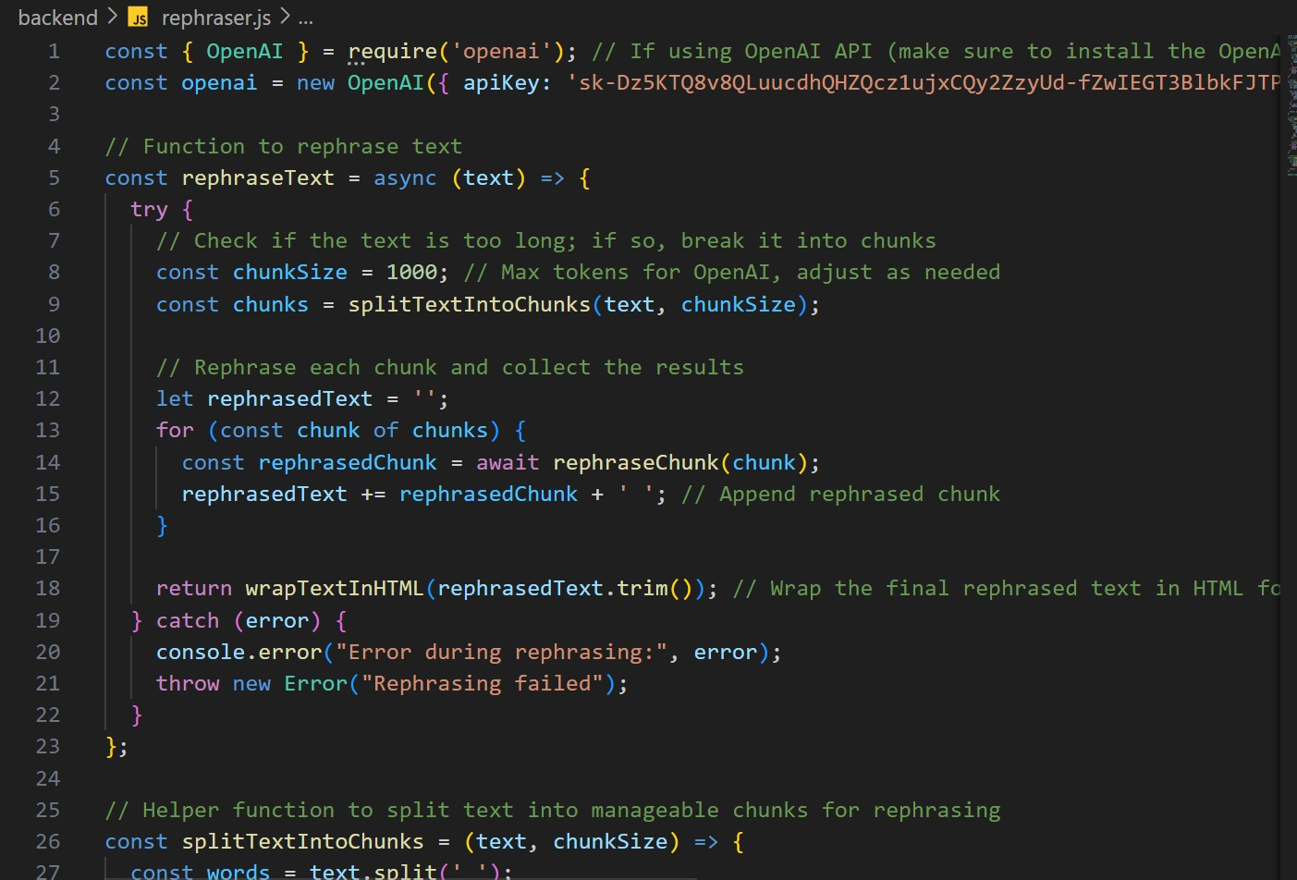
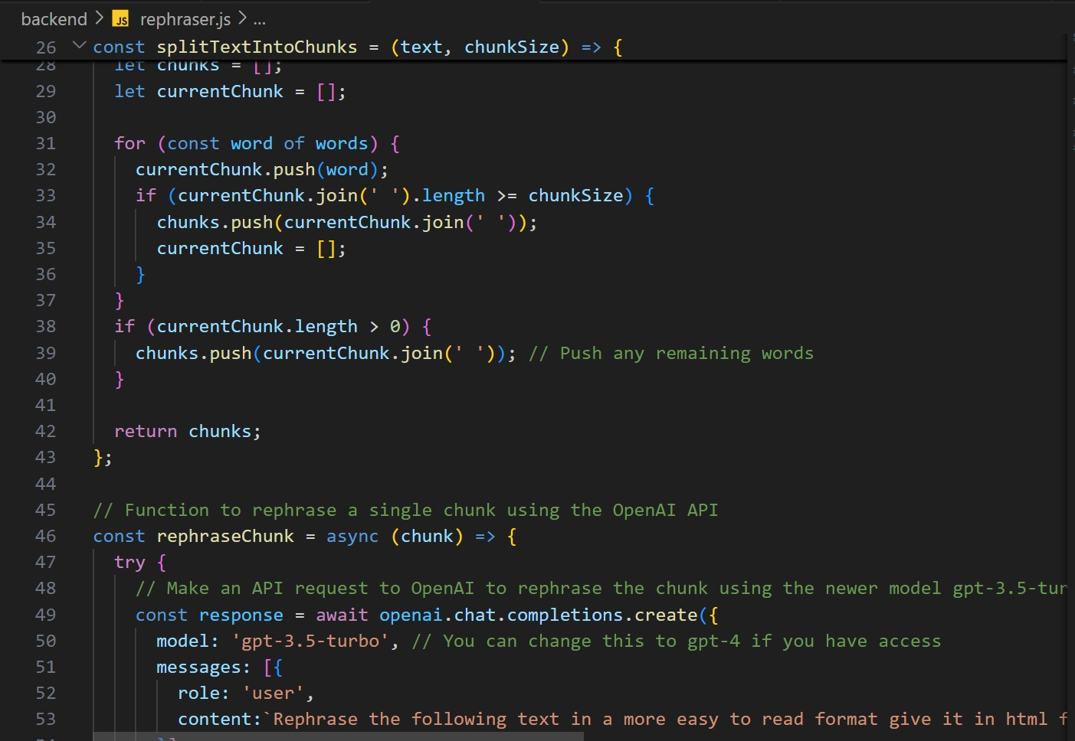

Slide 12
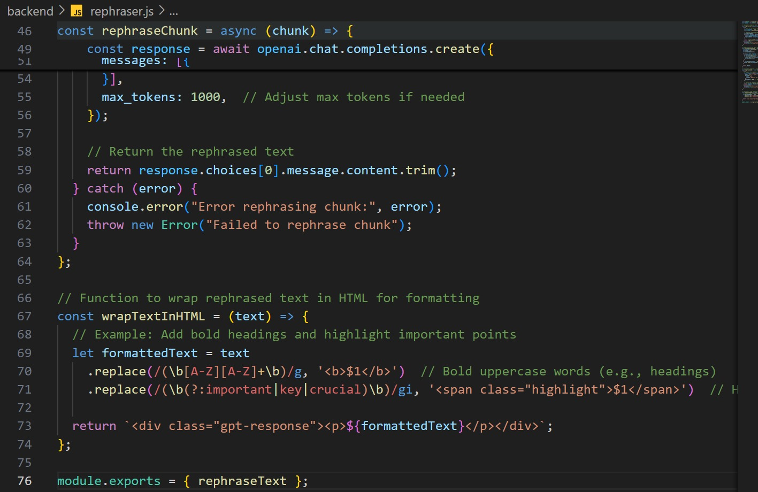
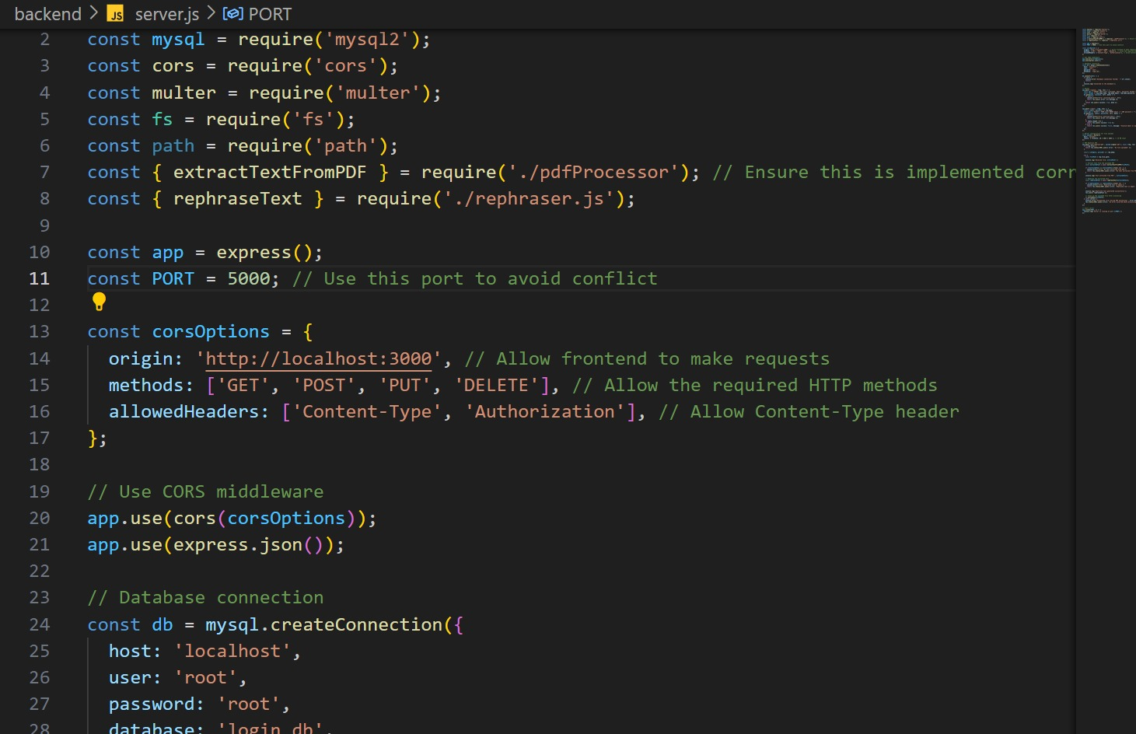

Slide 13
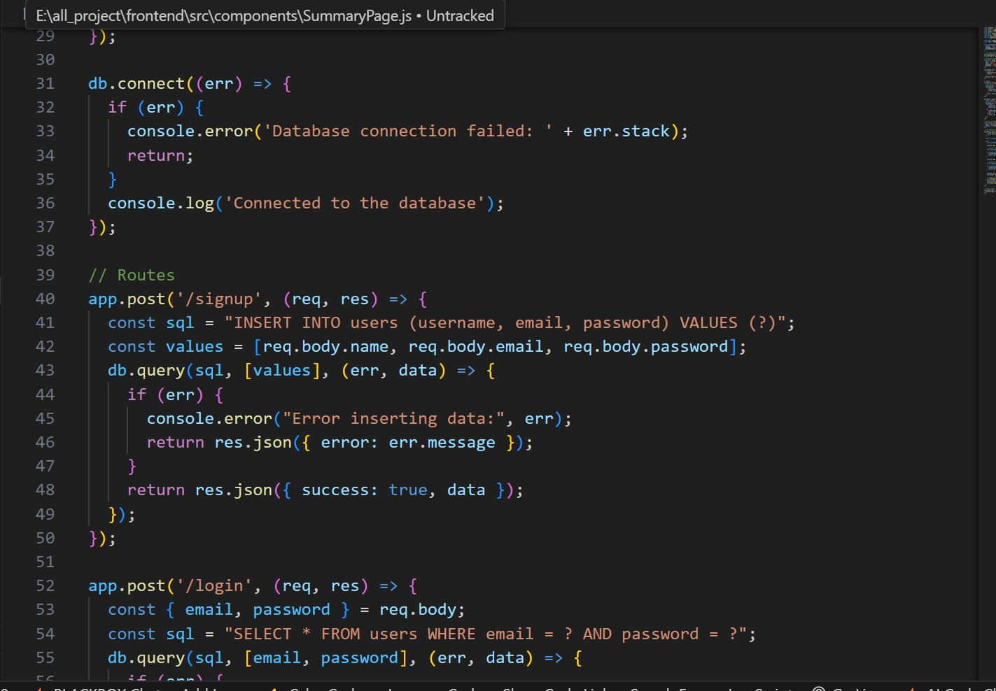
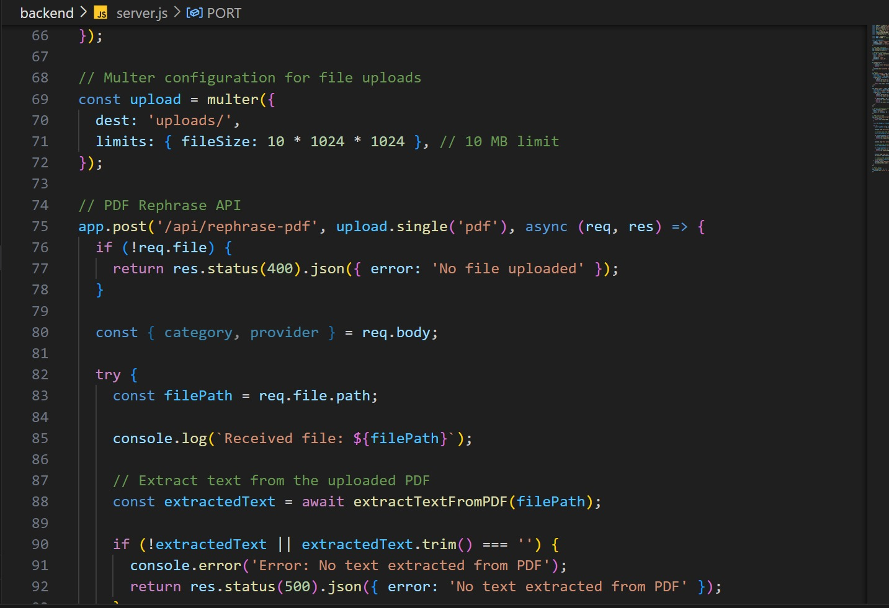

Slide 14
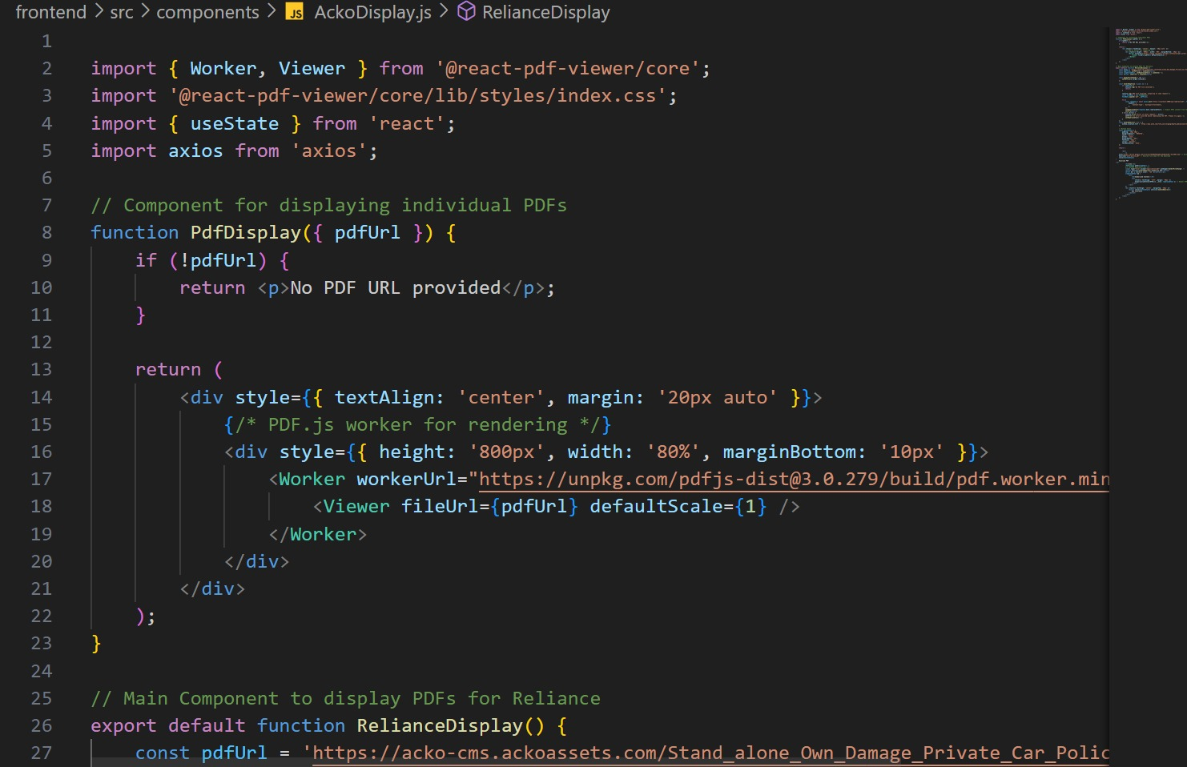
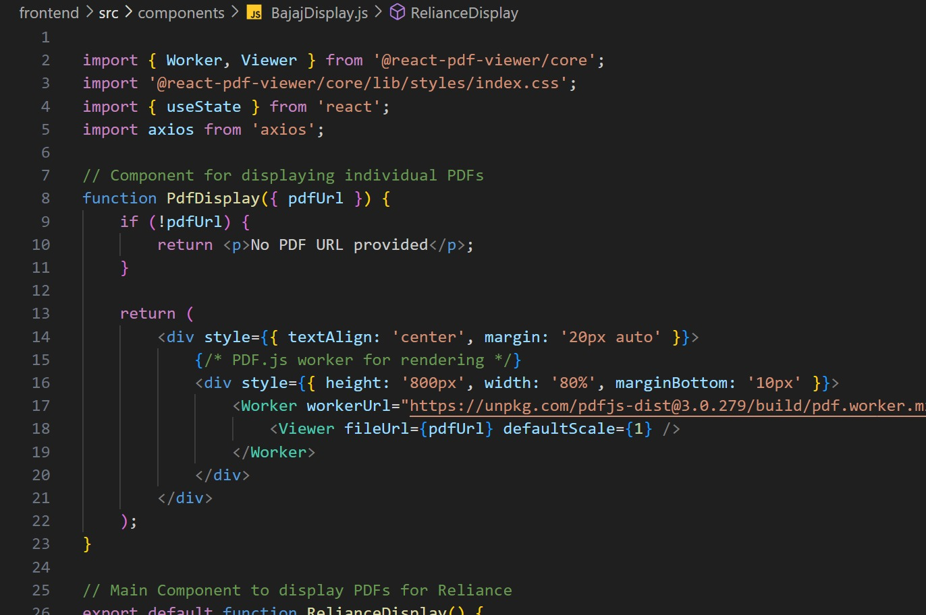

Slide 15
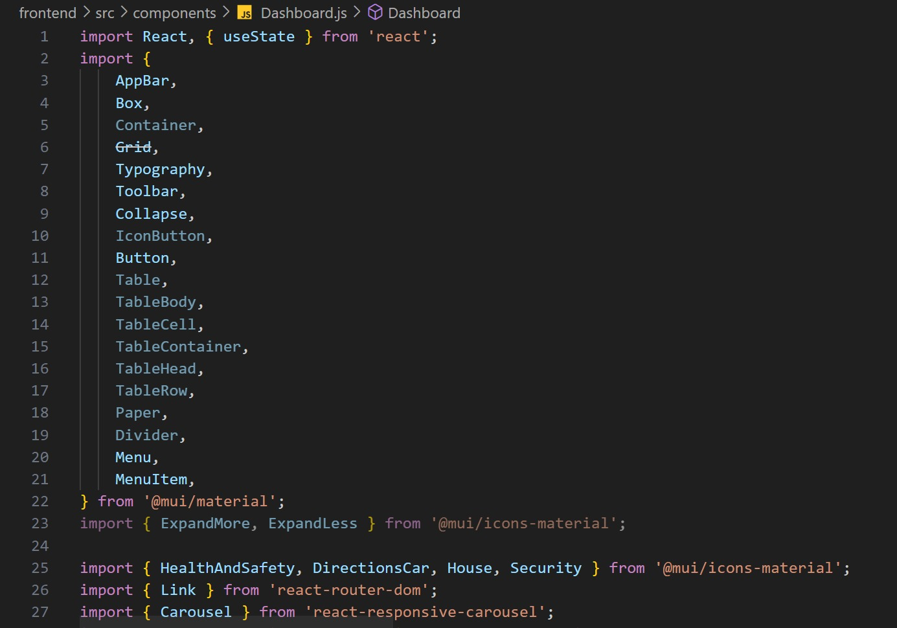
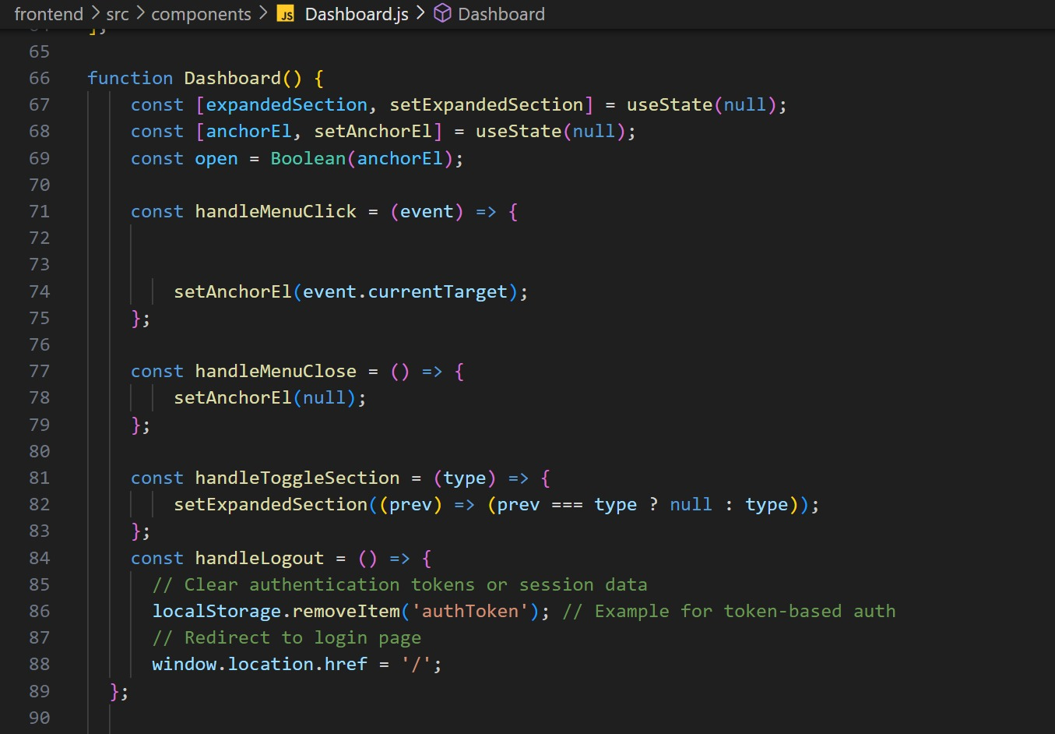

Slide 16
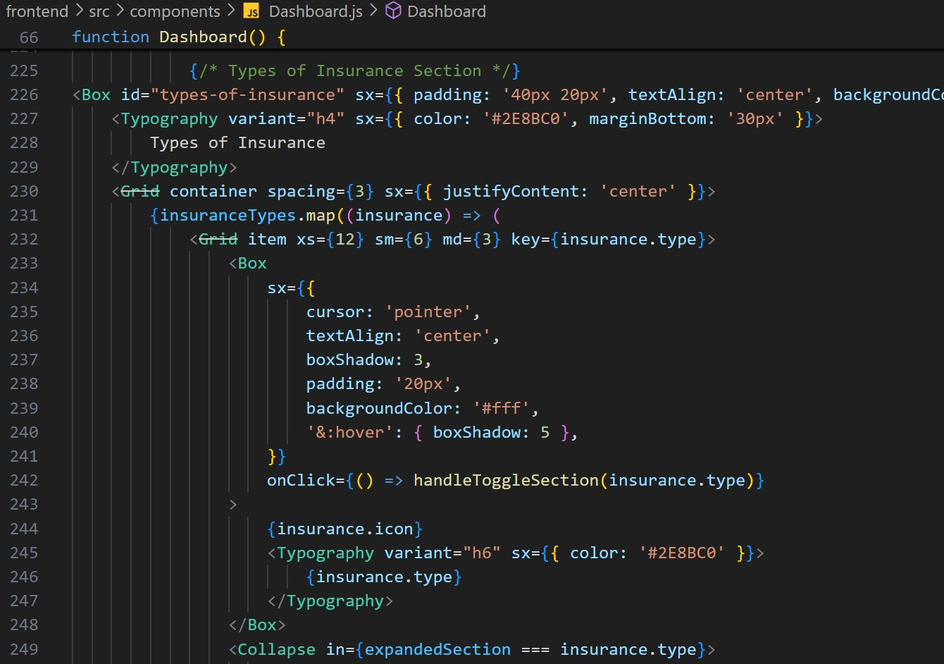
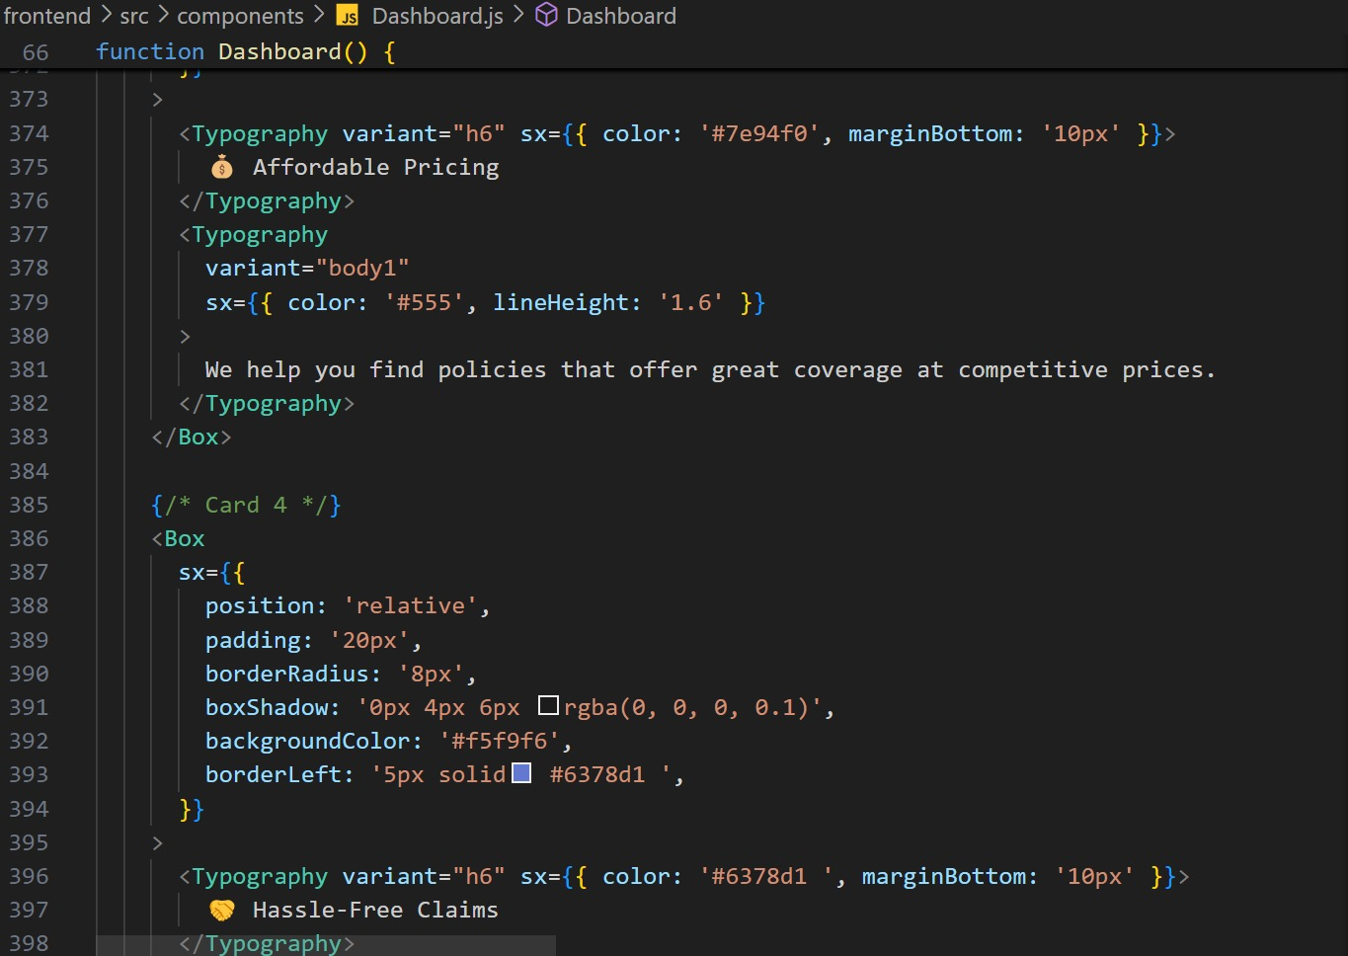

Slide 17
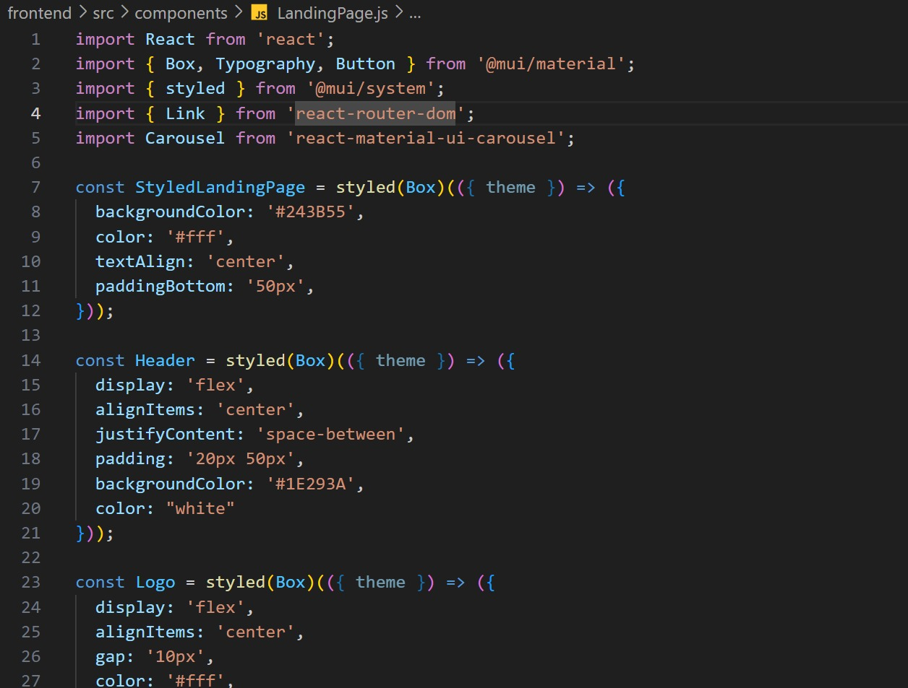
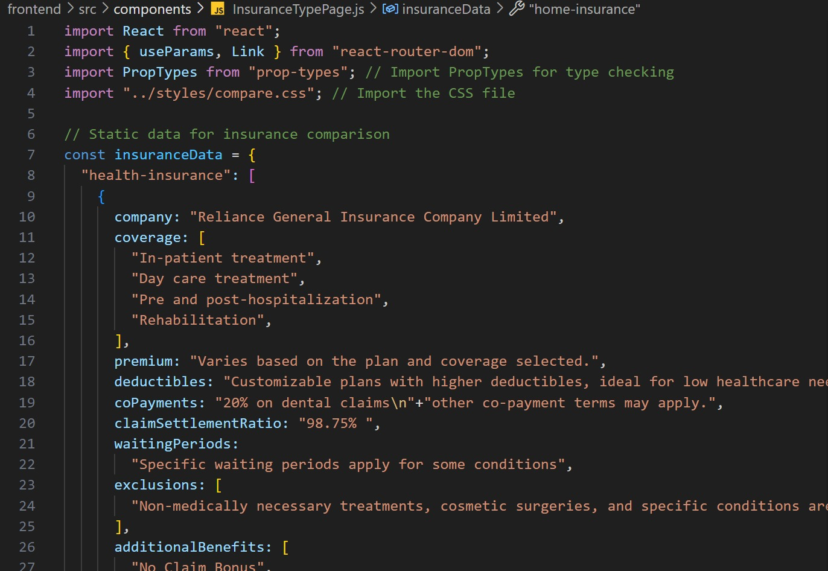

Slide 18
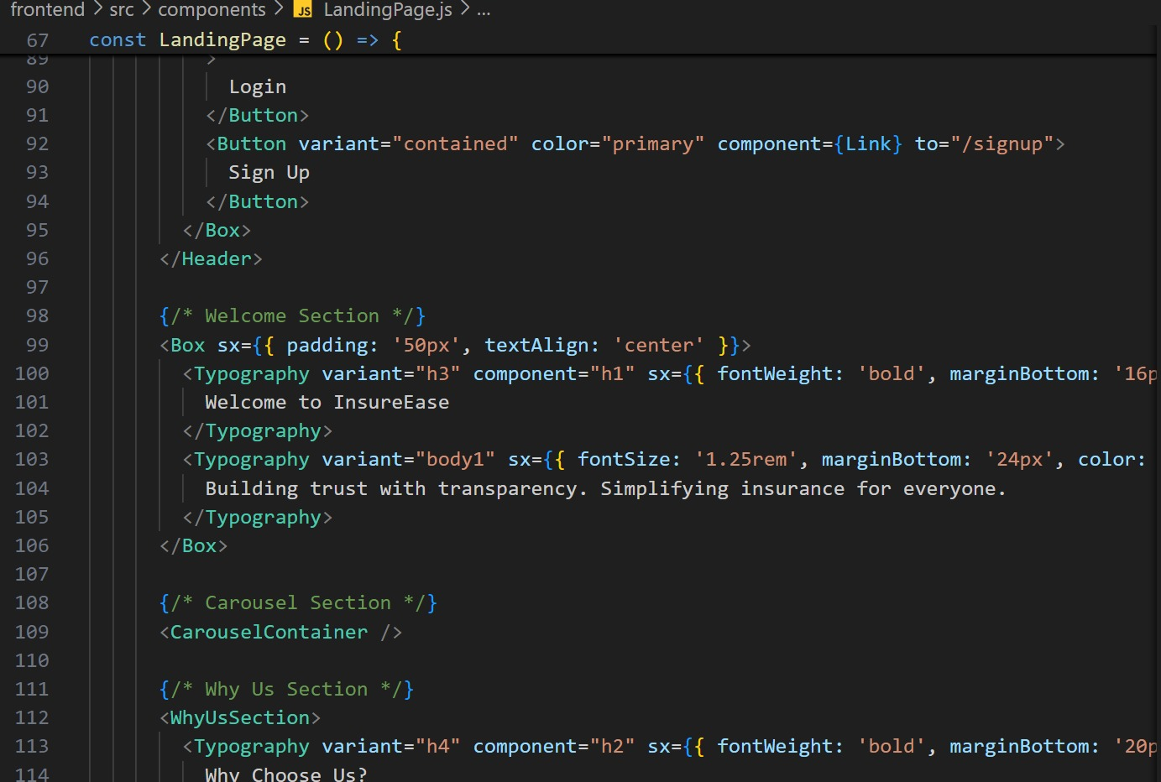
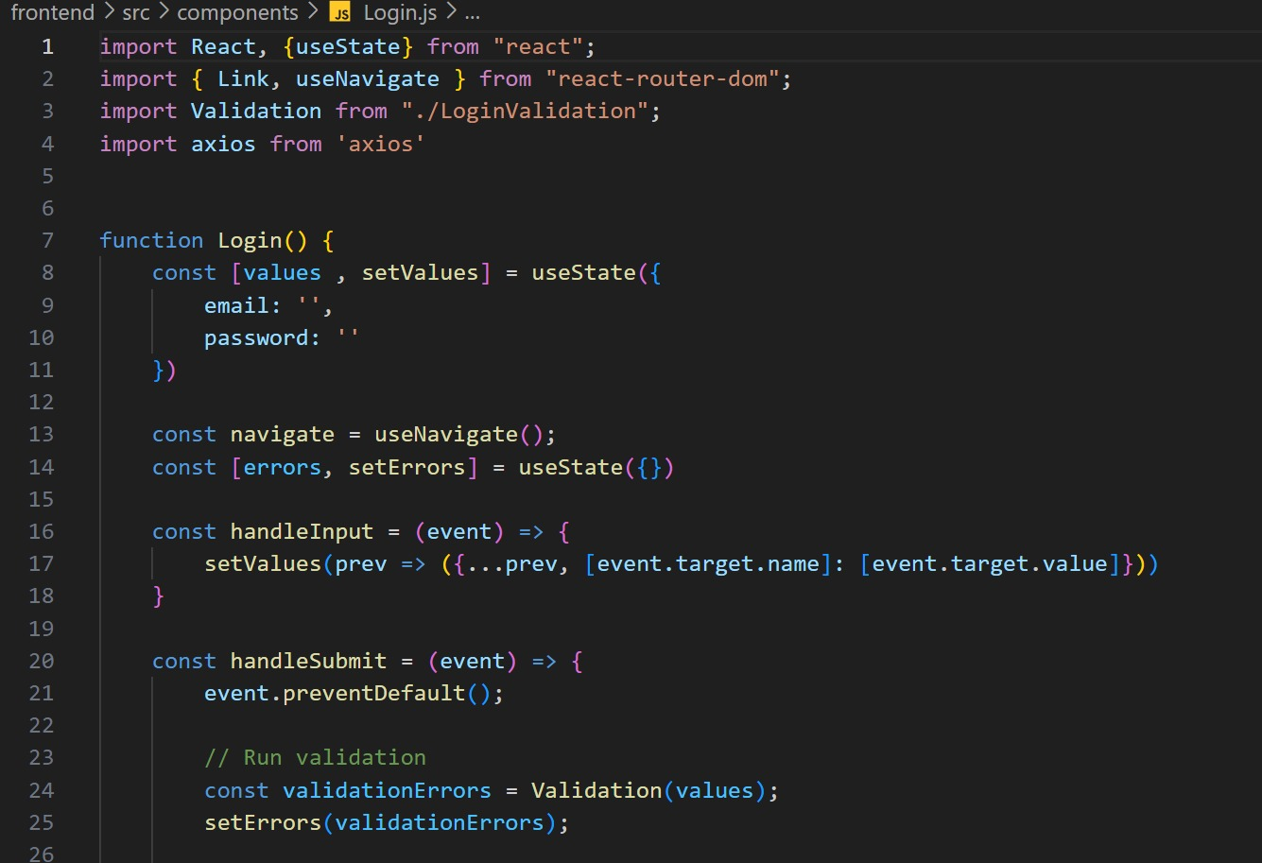

Slide 19
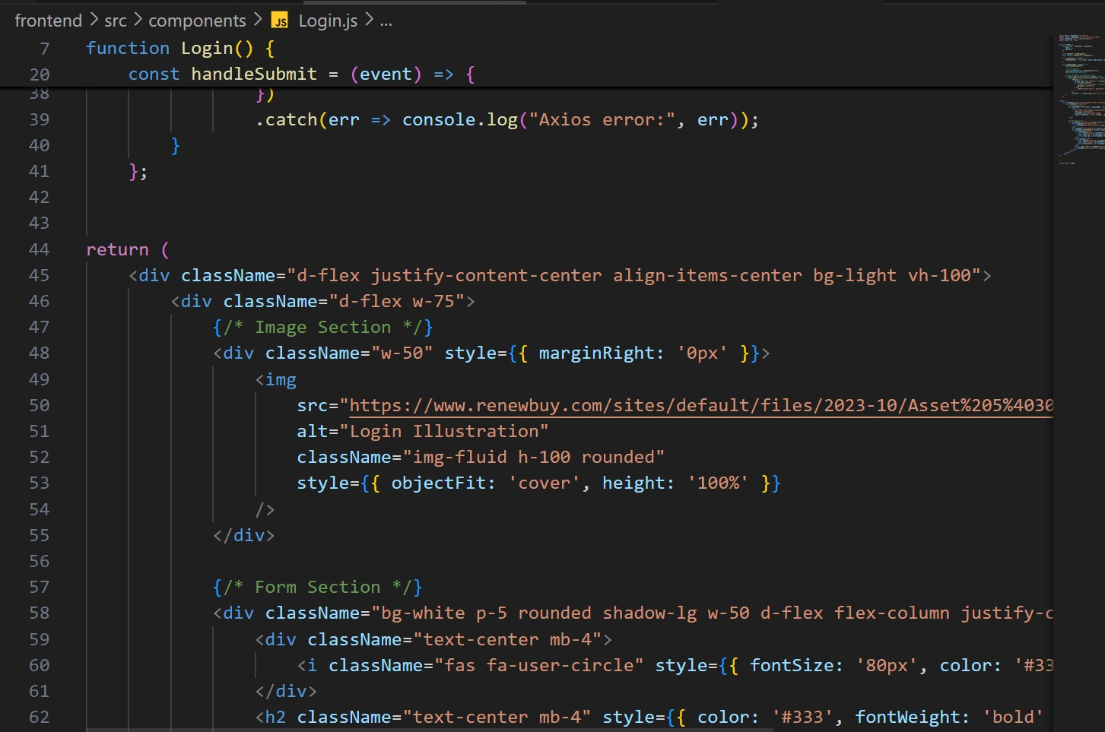
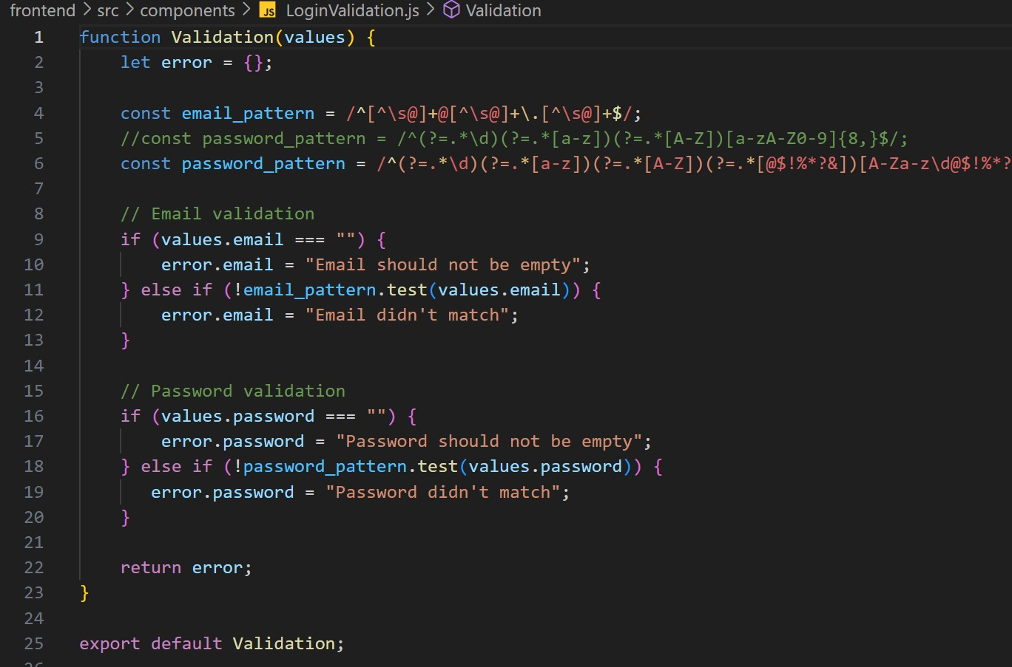

Slide 20
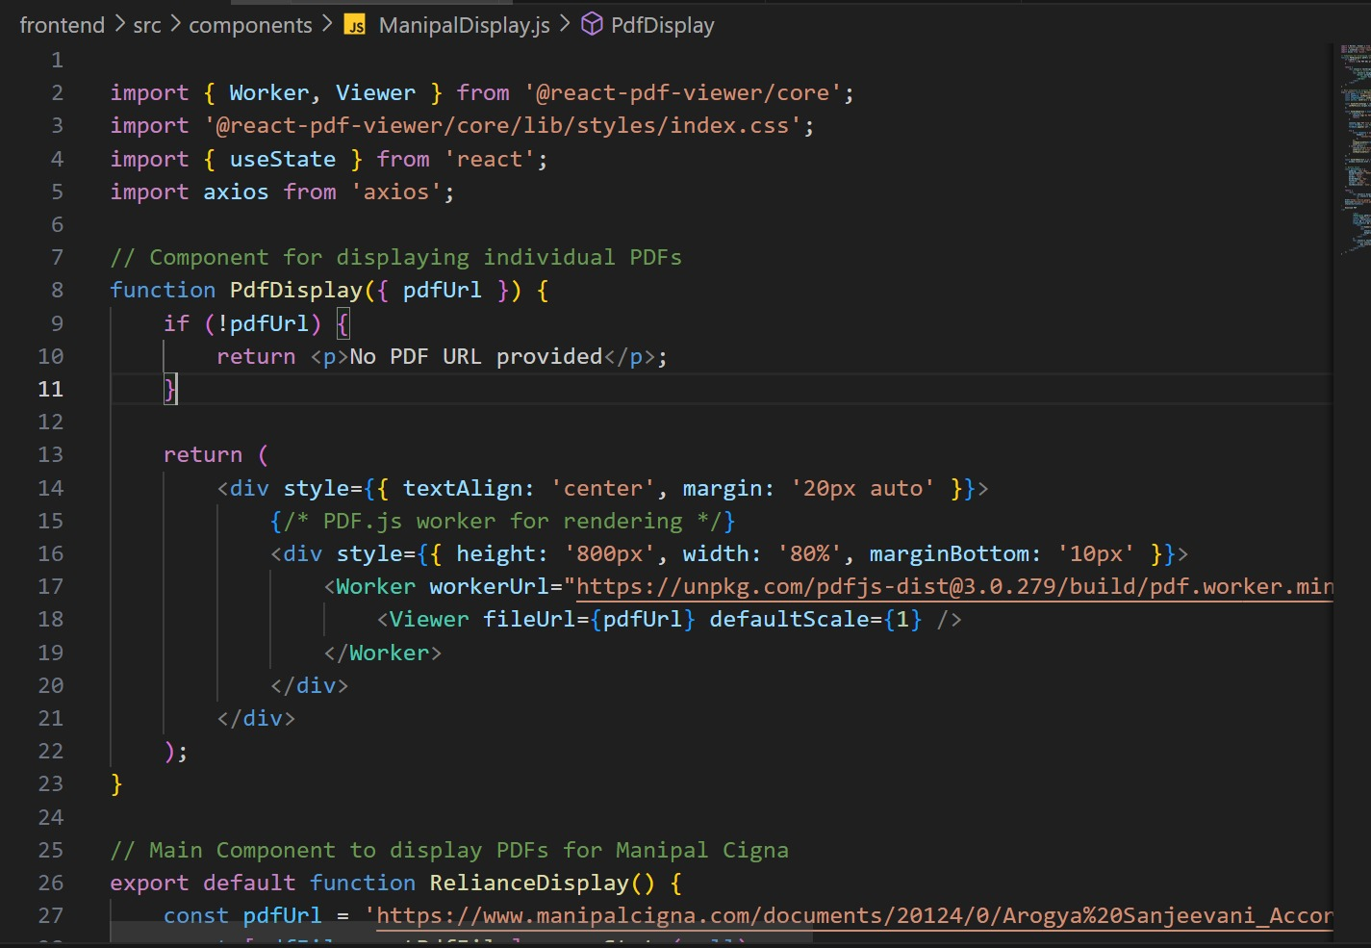
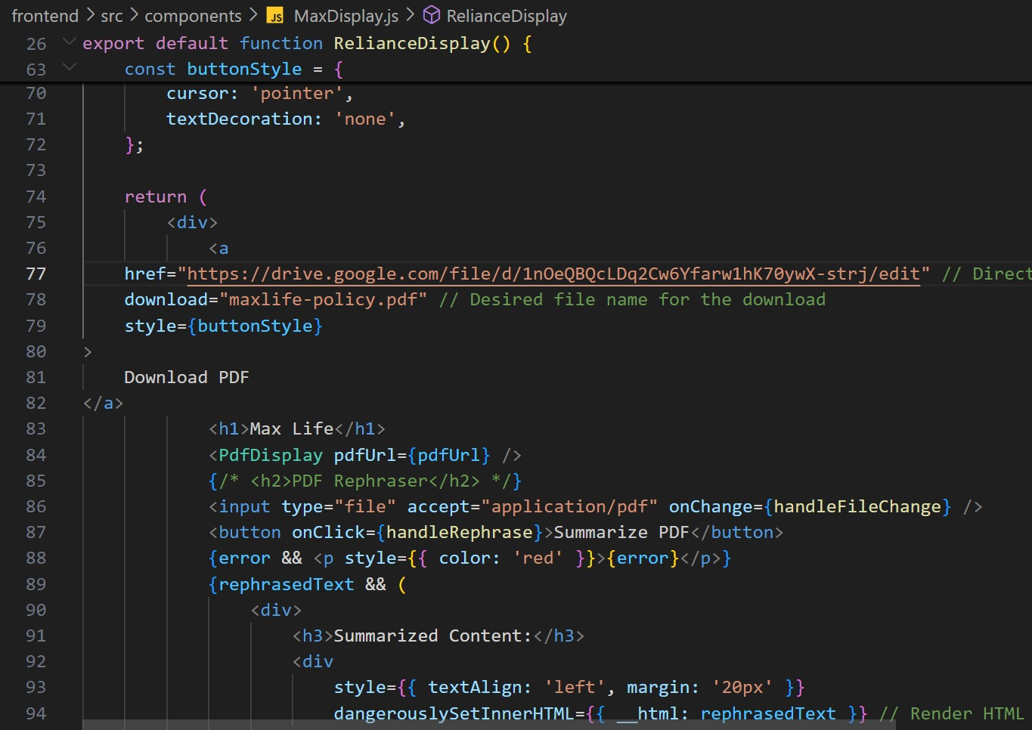

Slide 21
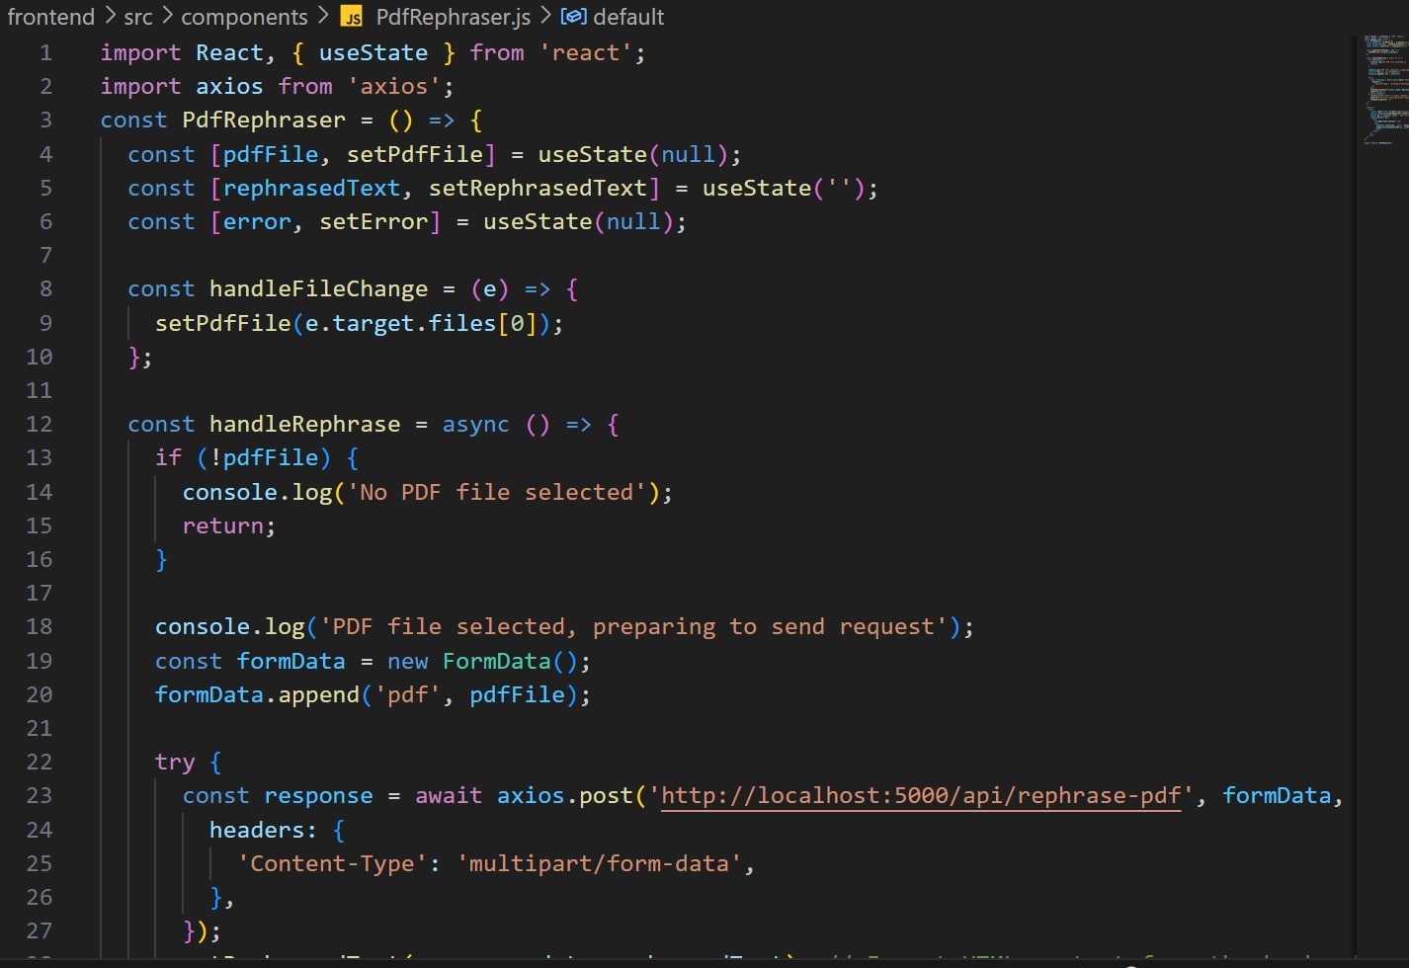
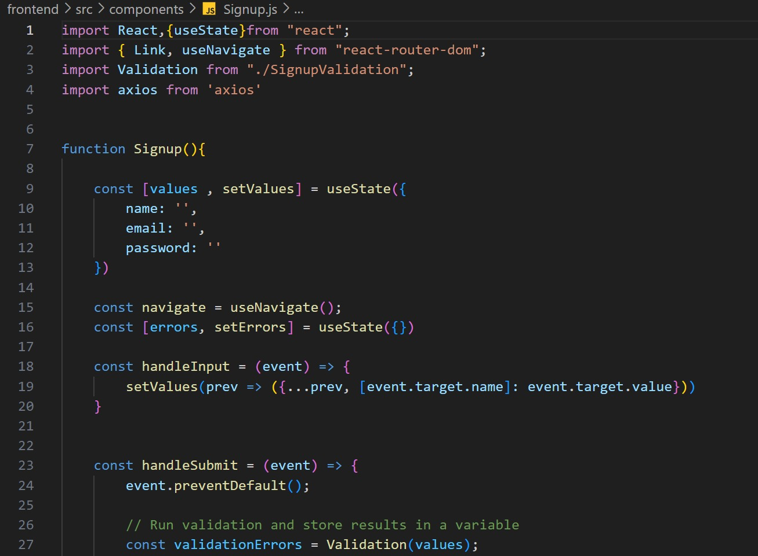

Slide 22
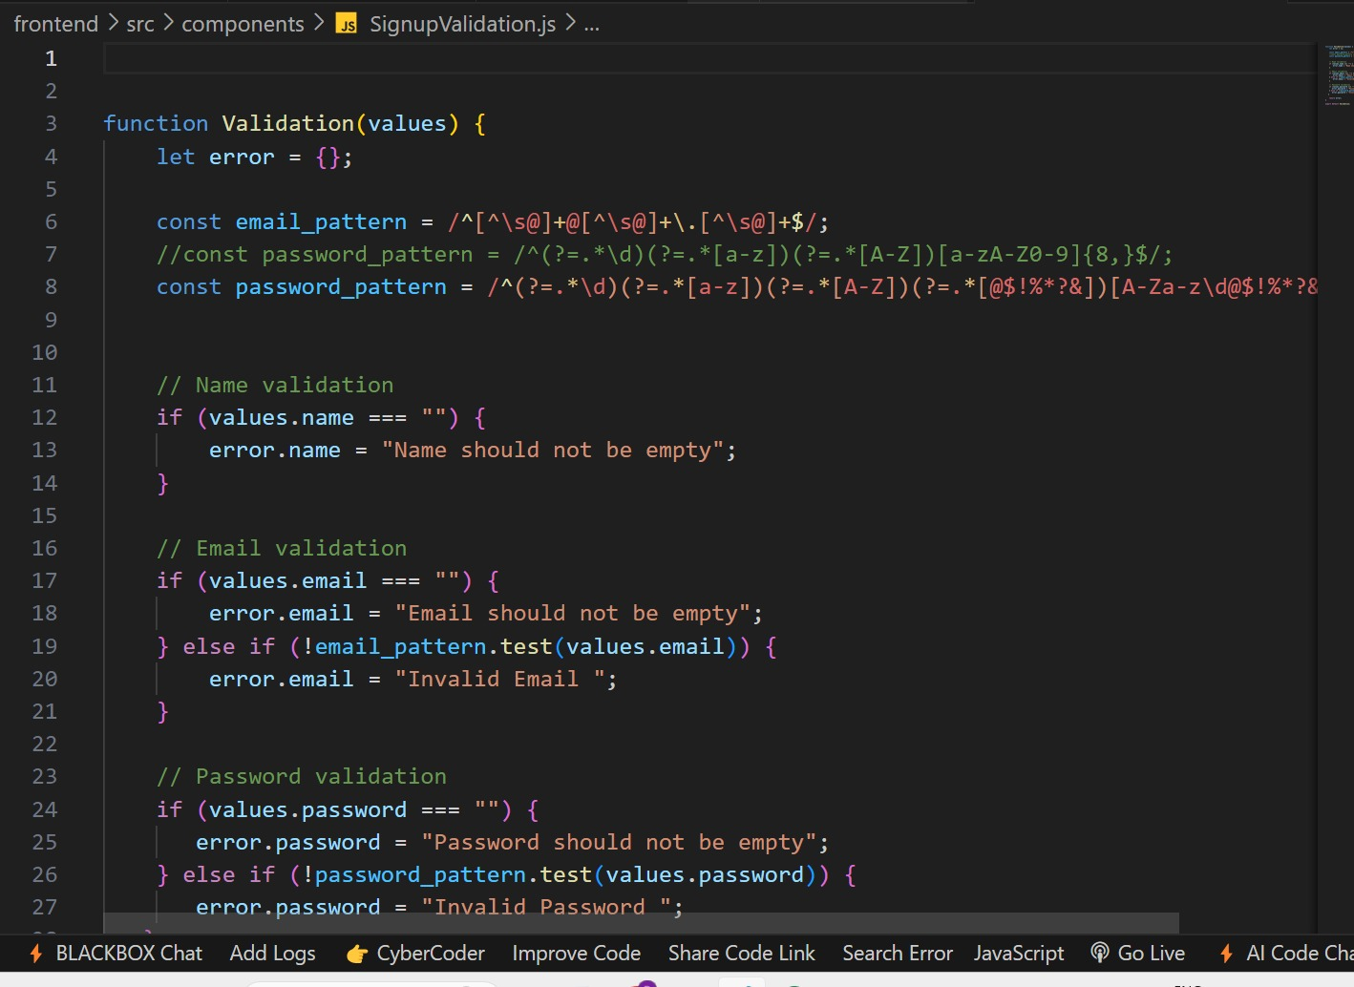
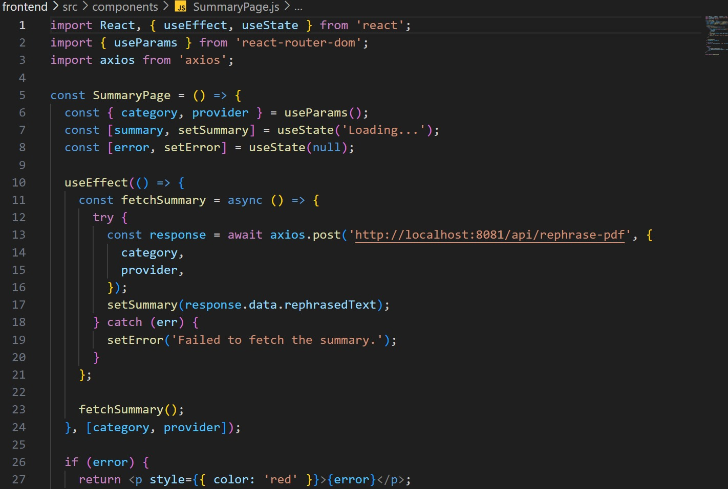

Slide 23
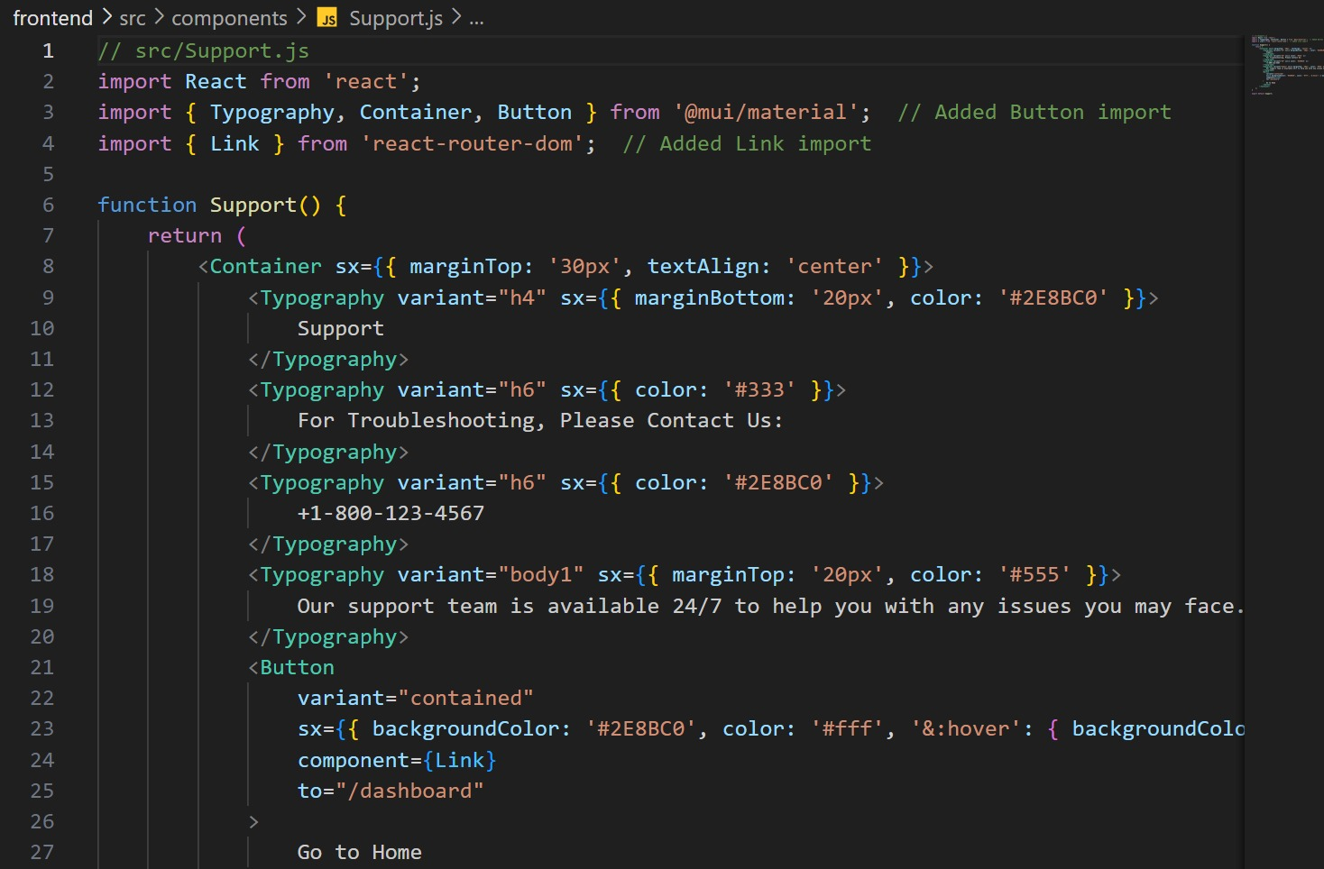
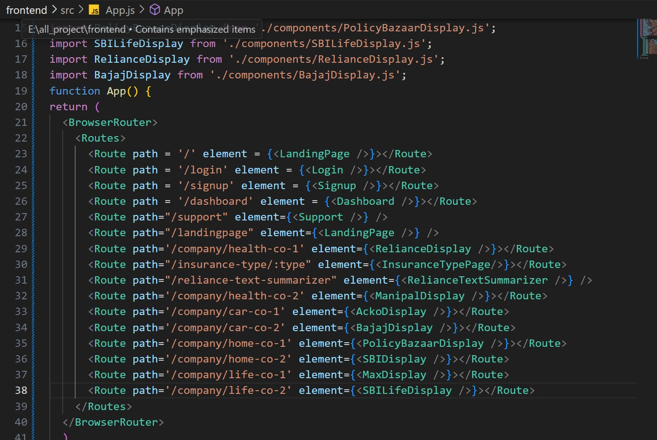

Slide 24
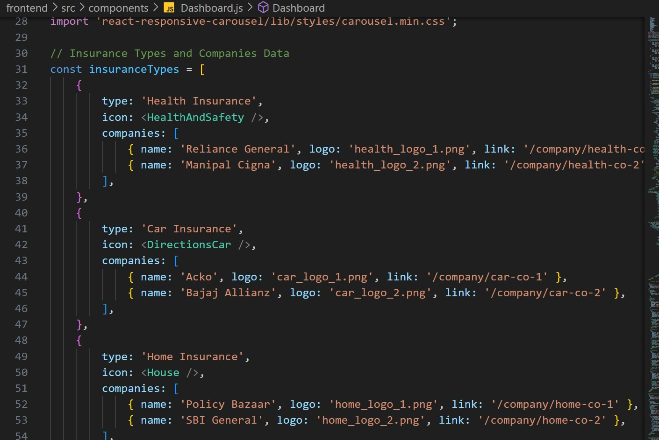
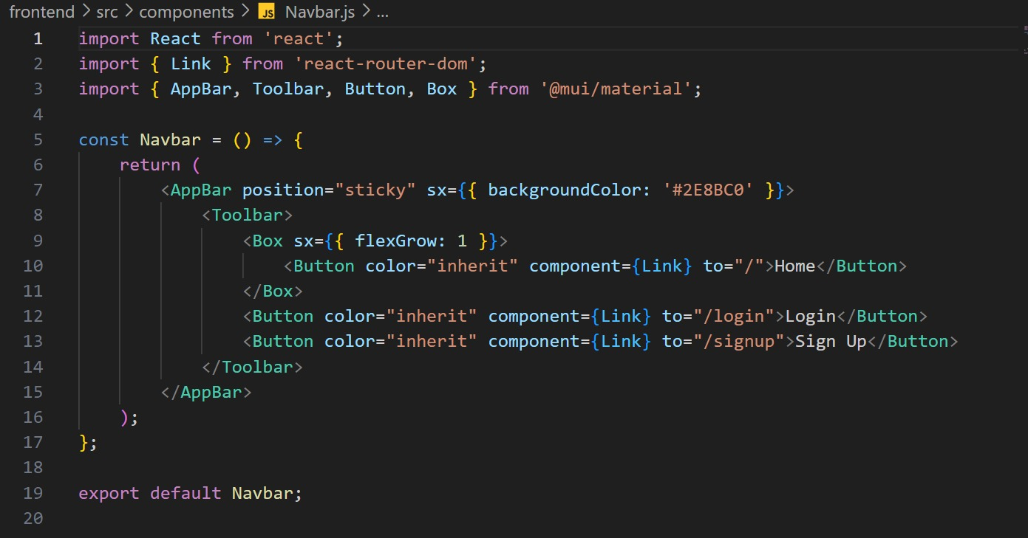

Slide 25
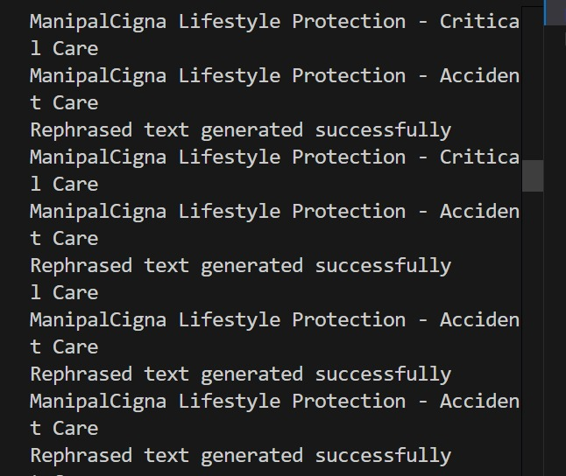

Slide 26
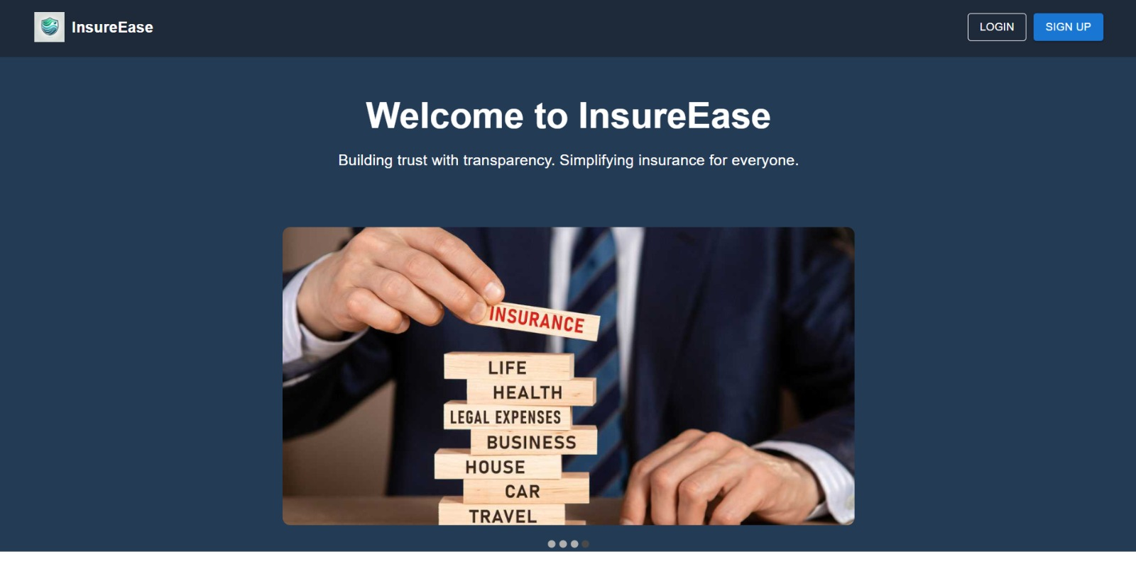
SCREENSHOTS

Slide 27
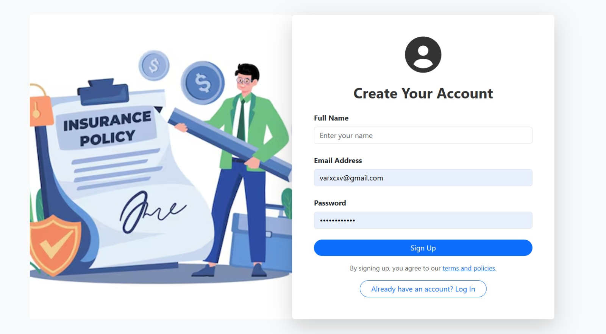
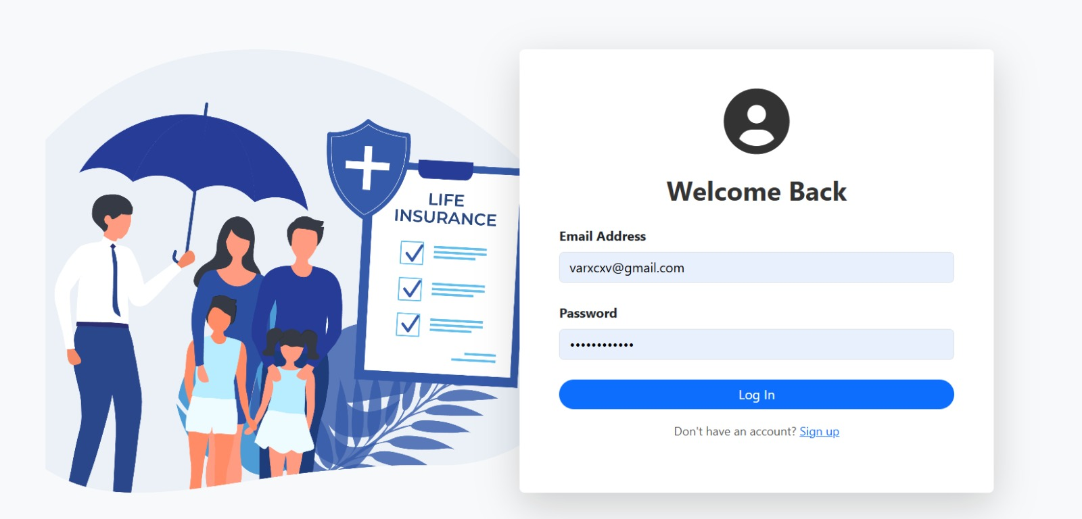

Slide 28
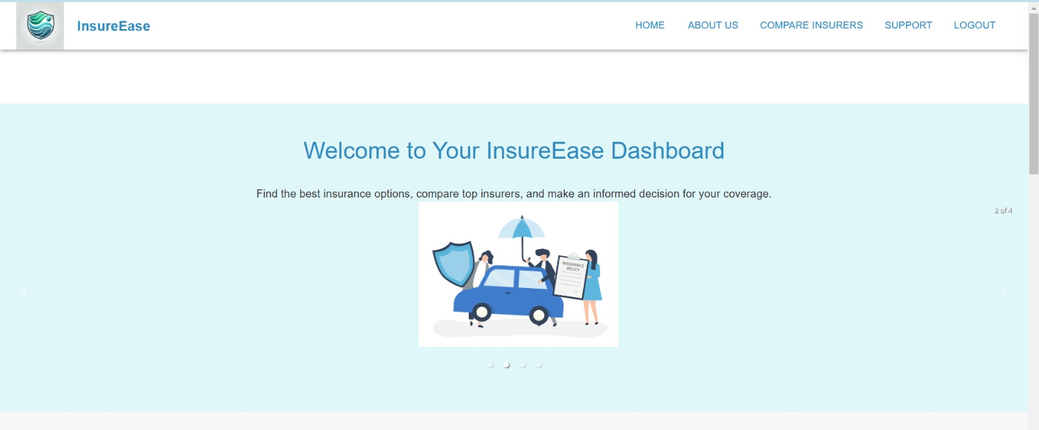

Slide 29
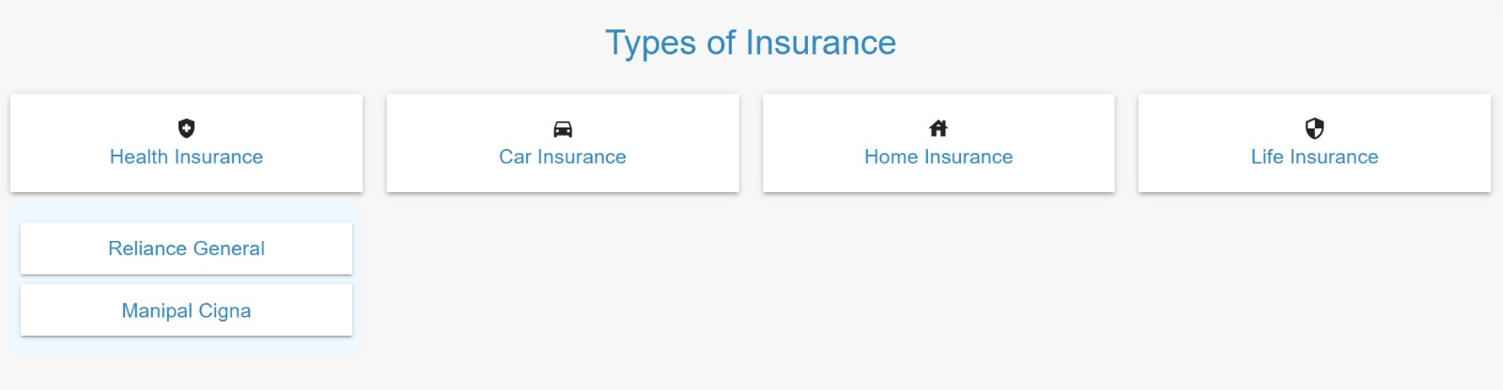
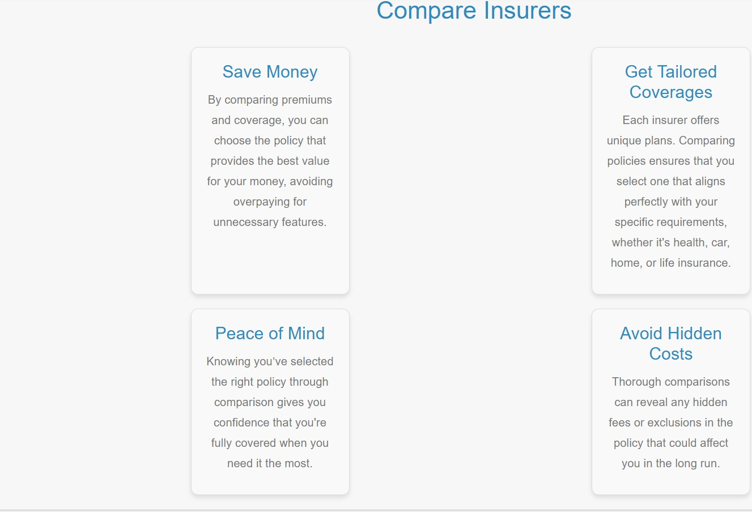
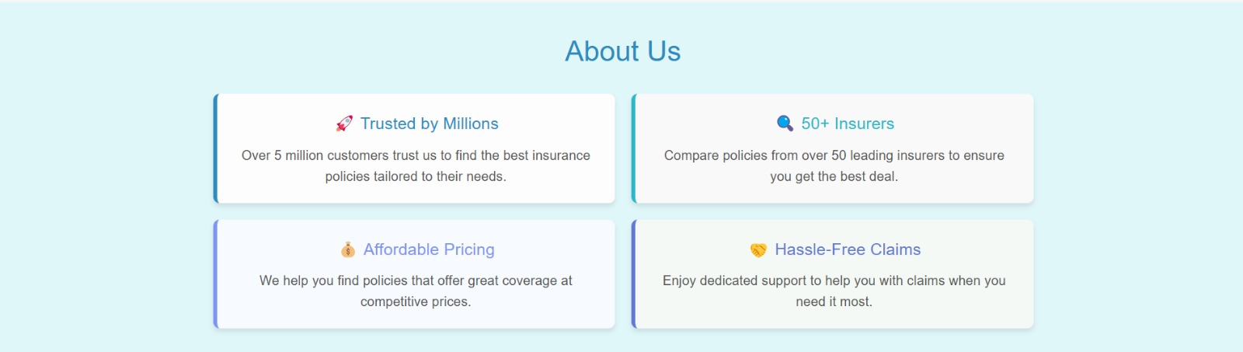

Slide 30

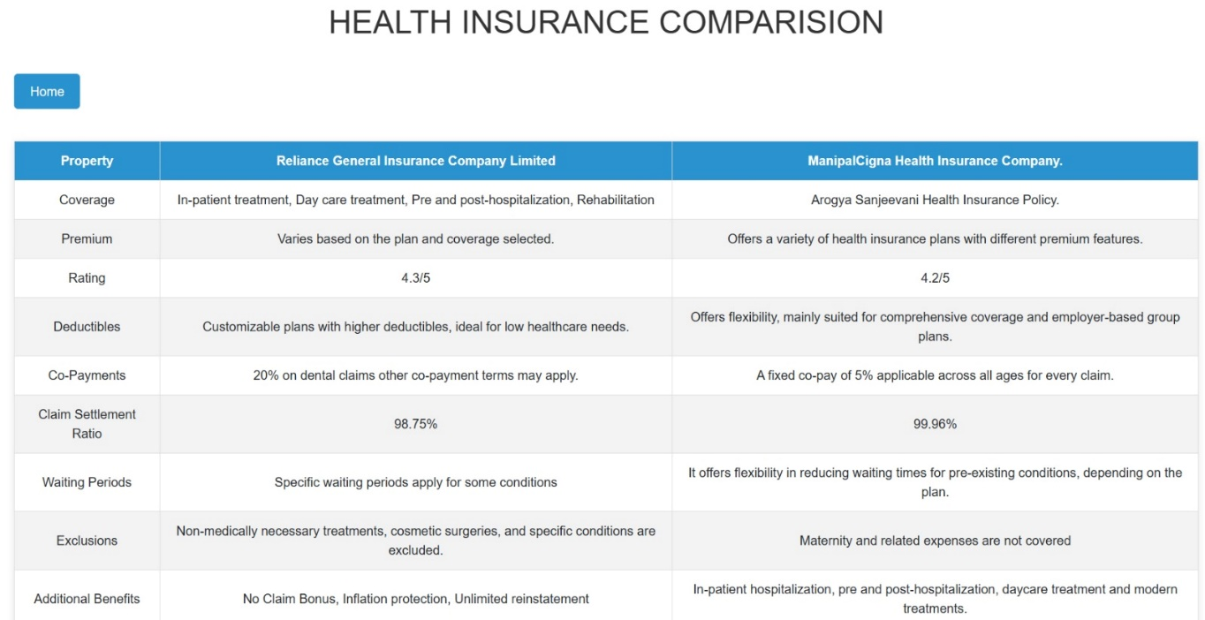
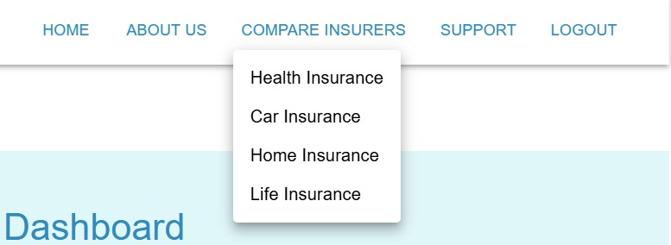

Slide 31
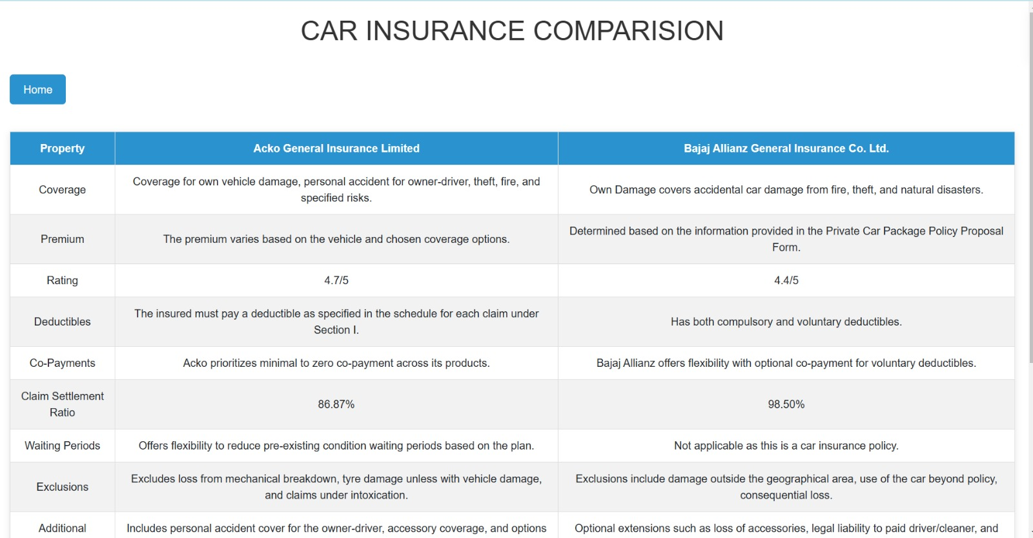
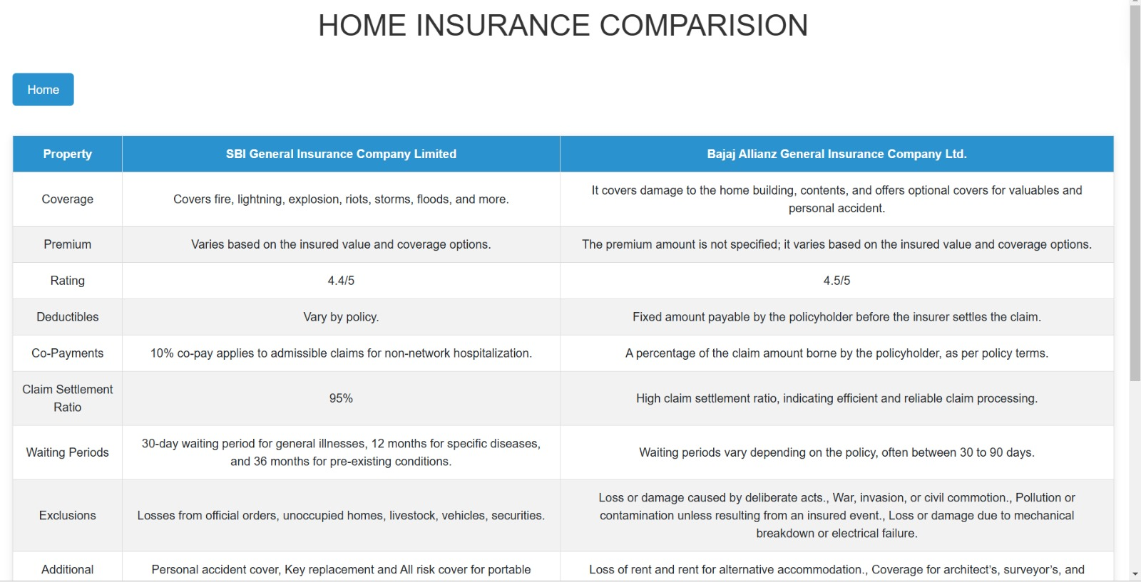

Slide 32
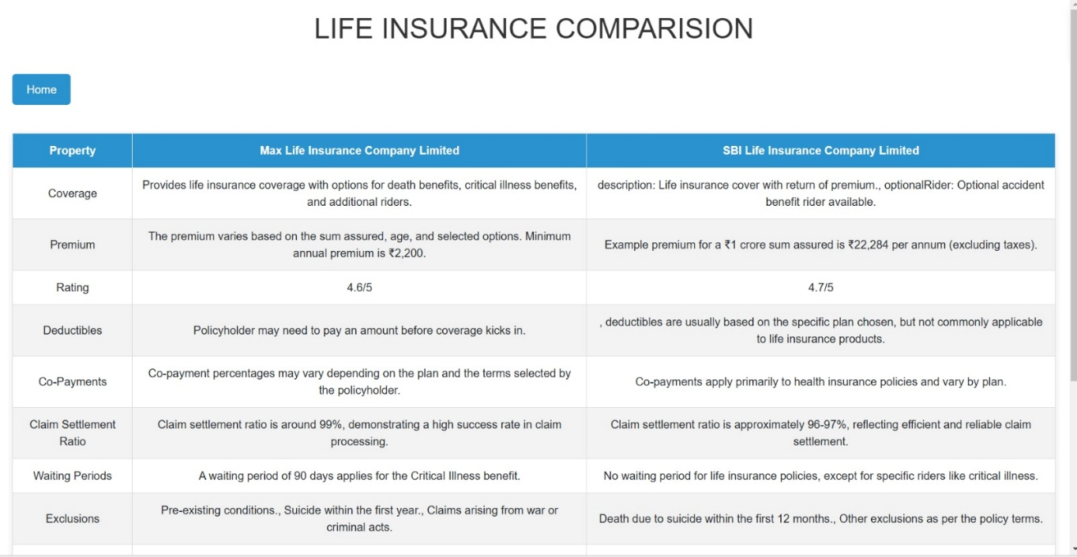
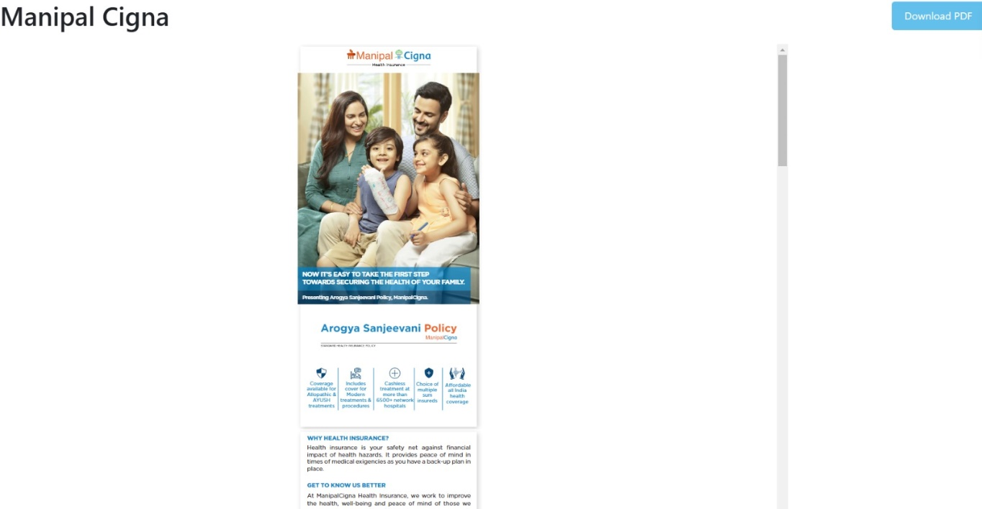

Slide 33
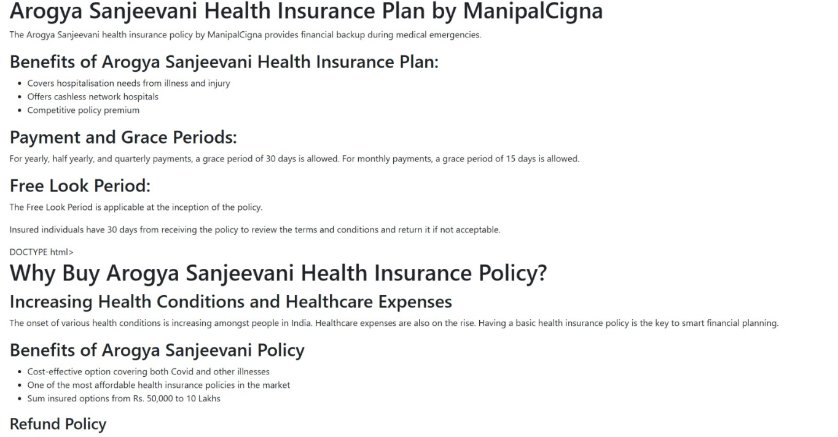
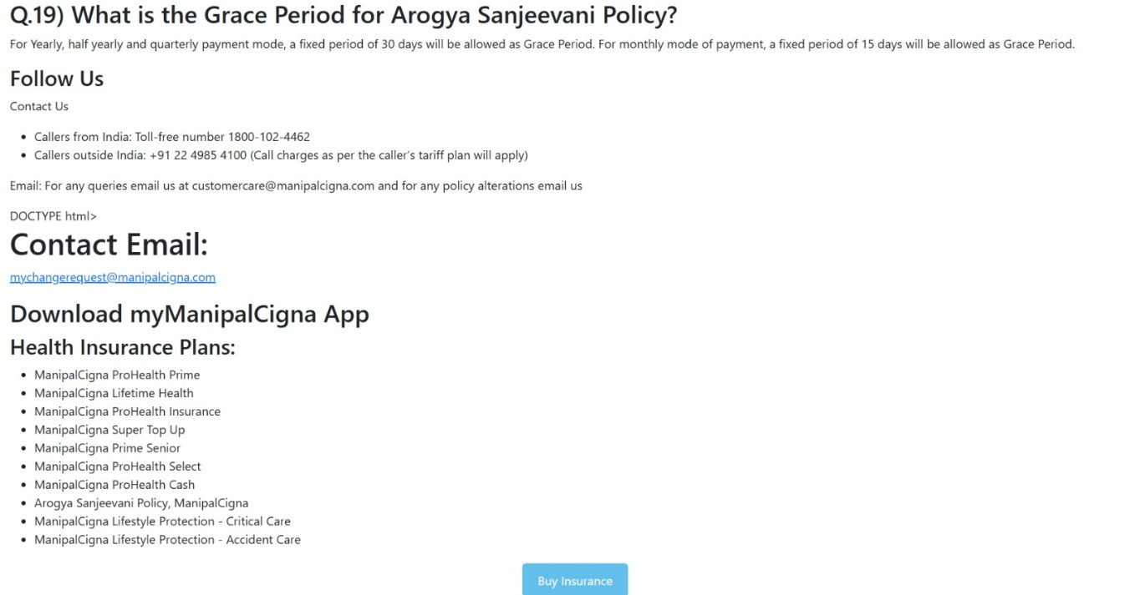

Slide 34
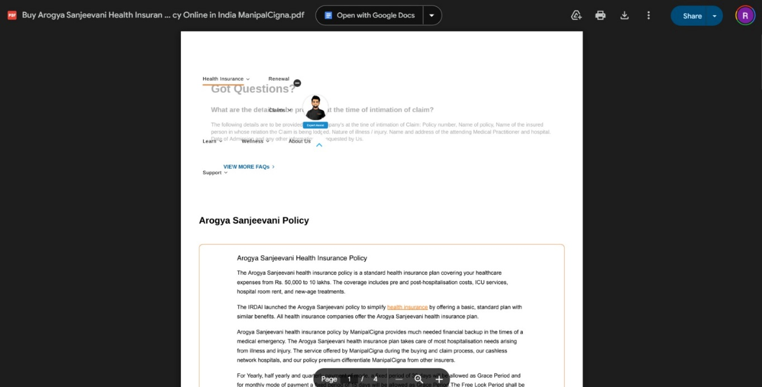
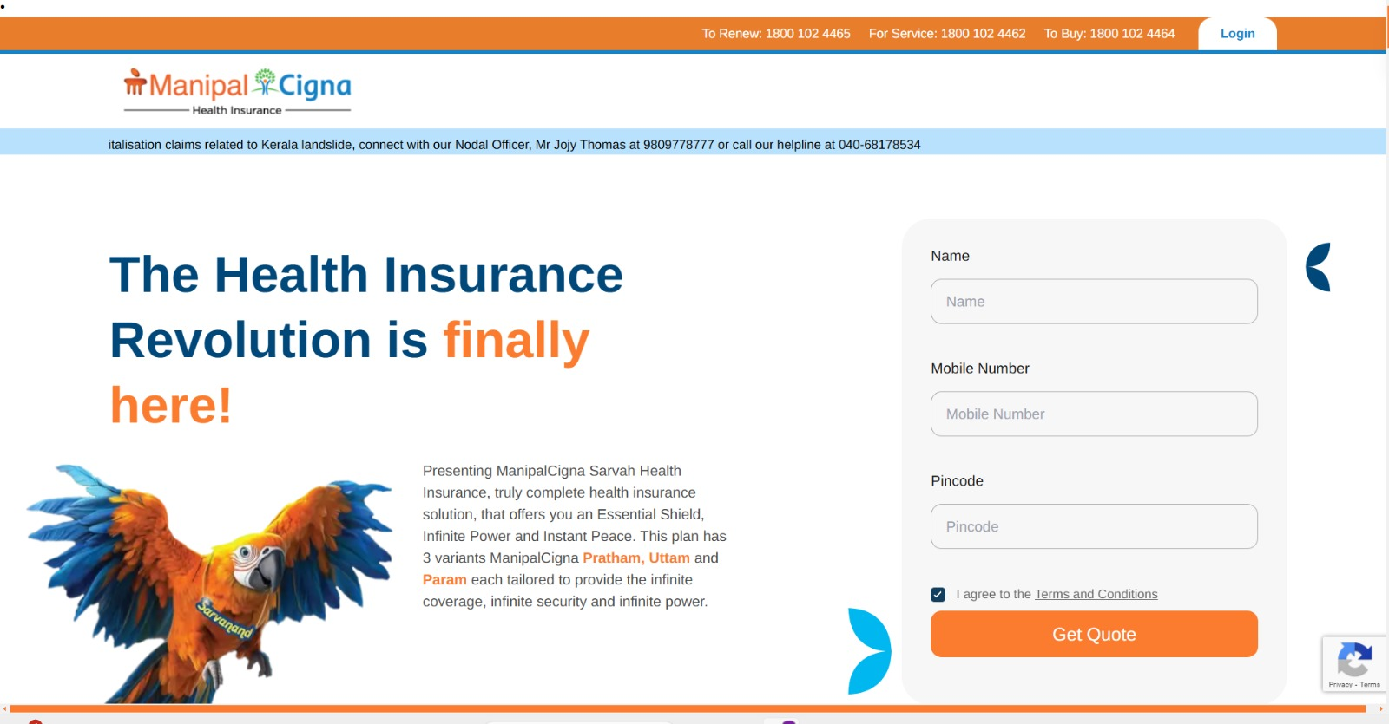

Slide 35
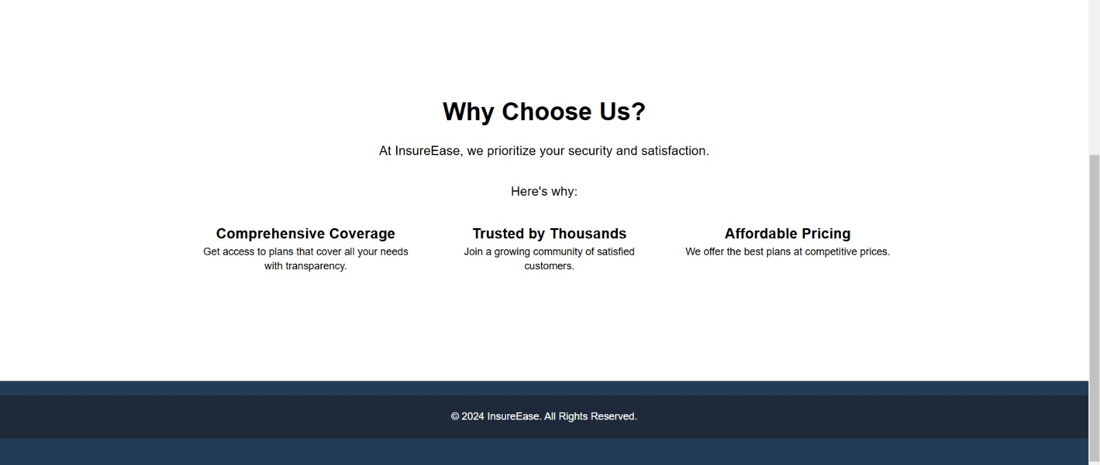


Slide 36
Thank You

